Slide 1
NIOS II EMULATOR Increment 5 Retrospective
Team 12
Team Members
Jake Ediger
Alex Michael
Alex Czarnick
Avinash Nooka
Raksharth Choudhary

Slide 2
Overview
Project Description
Requirements
Implementation
Testing
Demonstration
Reflection

Slide 3
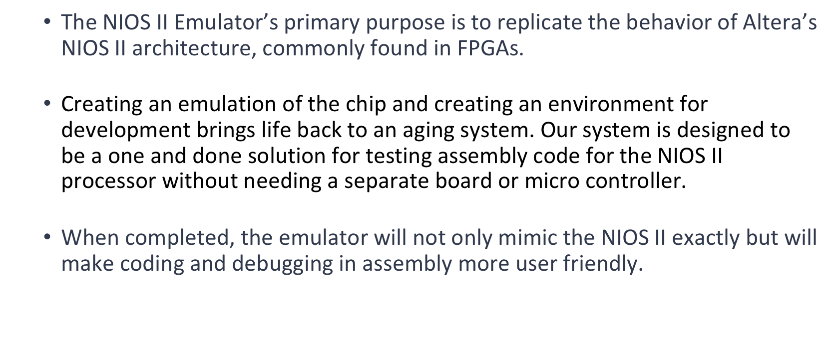
Project Overview

Slide 4
Functional Requirements
F1: Read in a text document of assembly instructions and labels by parsing each line and executing them correctly by identifying which instructions, registers, and labels are being used.
F2: Simulate a 32 bit, little endian processor environment with 16 bit memory addresses and 32 general purpose registers. Although these addresses will be simulated, they will behave the same as an actual NIOS II processor.
F3: Display current processor state as; “RUNNING,” “PAUSED,” and “NOT READY.” This will be done through the GUI.

Slide 5
Functional Requirements
F4: Represent a 64 kilobyte byte-addressable block of memory for specific data accessibility. Like F2, this memory will be simulated but behave identically to the NIOS II memory.
F5: Display Program Counter value and contents of the 32 general purpose registers and special registers. These values will be shown in the GUI.

Slide 6
Functional Requirements
F6: Run, Pause, and Reset buttons for controlling the program.
F7: The user will have the ability to specify up to 16 memory locations to the monitor. For each user specified memory location, the program should display the four contiguous bytes starting at that memory location in hexadecimal.

Slide 7
Nonfunctional Requirements
N1: Performance
The system should provide an execution time that is indistinguishable from the actual NIOS II chip
The system should show data to the GUI in real-time
N2: Usability
The input file format will be clearly described to avoid pre-runtime errors
The GUI should be intuitive to use for anybody with experience in NIOS II
Errors that occur will be clearly described to the user to aid debugging

Slide 8
Nonfunctional Requirements (cont.)
N3: Stability and Reliability
The system should be able to handle basic errors while providing information on bugs
N4: Platform Compatibility
The system will be able to run on multiple operating systems, provided the correct software is installed beforehand
The system will provide an almost identical look across all compatible operating systems

Slide 9
Overview
Project Description
Requirements
Implementation
Testing
Demonstration
Reflection

Slide 10
Implementation
Target Platform:
Web
Go to localhost:8001
Language:
Javascript, HTML, CSS
Javascript for logic
HTML and CSS for user interface and interactivity
Libraries:
None

Slide 11
Overview
Project Description
Requirements
Implementation
Testing
Demonstration
Reflection

Slide 12
Testing: Traceability
***Live Demo***
Testing User Interface

Slide 13
Testing: Traceability
***Live Demo***
testCaseInfiniteLoop.txt
Ability to pause, run, and restart program. Also the registers are updated when paused, and the memory locations can be displayed.

Slide 14
Testing: Traceability
testCaseInfiniteLoop.txt
.text .global _start _start: movi r2,2 movi r3,5 movi r4,10 begin: add r2,r2,r2 add r3,r3,r3 addi r4,r4,10 br begin .data .end
File uploads correctly.
System is ran.
Nothing is updated until program is paused.
Able to continue running program, or restart program.
Can change viewable memory locations.

Slide 15
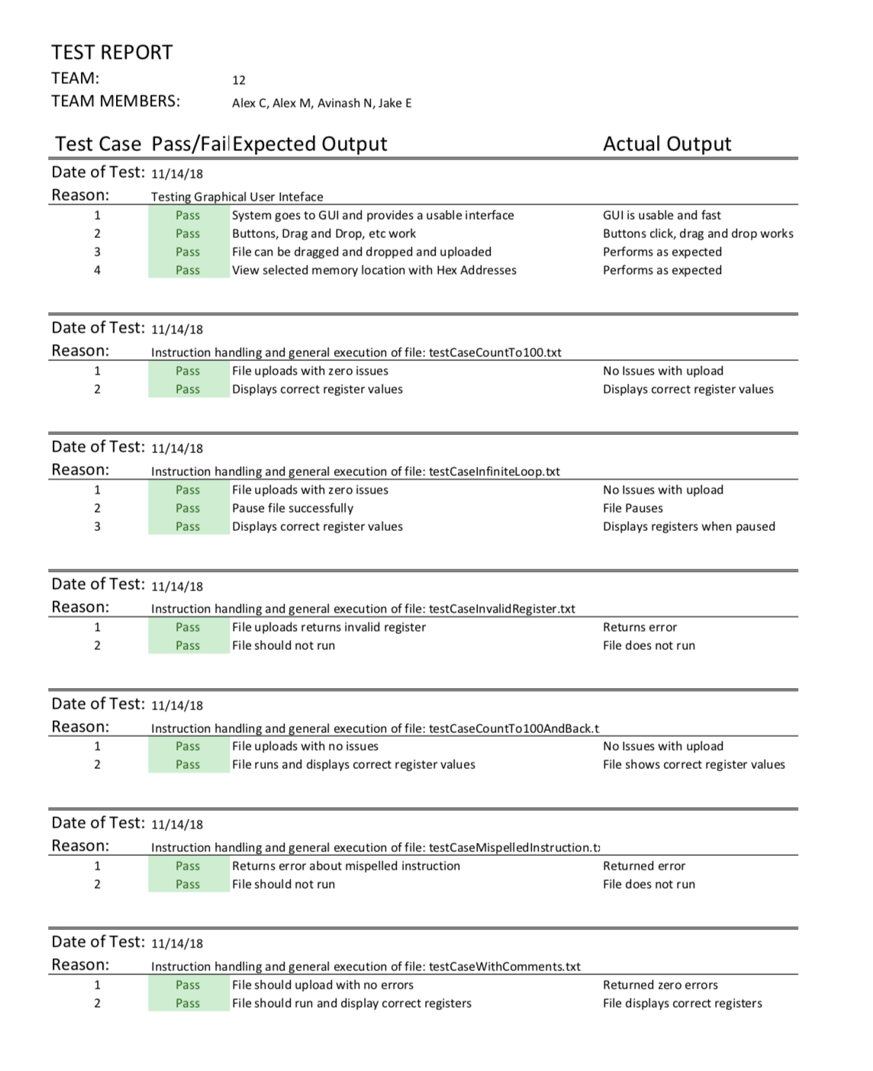
Test Report

Slide 16
Overview
Project Description
Requirements
Implementation
Testing
Demonstration
Reflection

Slide 17
Demo
Live Demo

Slide 18
Overview
Project Description
Requirements
Implementation
Testing
Demonstration
Reflection

Slide 19
Reflection What went well
The coordination of the different subsystems worked very well despite different people working on different components simultaneously. This was made possible by constant communication between team members and a solid plan going in.
Some refactoring was necessary when we realized a certain implementation wouldn’t work, but the Jetbrains IDE Webstorm made it very easy/quick, where as it manually it would have taken hours.
We were unsure how well Javascript would work with global variables and functions, but it ended up being very easy to share information between the components (i.e. sharing PC between main.js and instructionhandler.js)

Slide 20
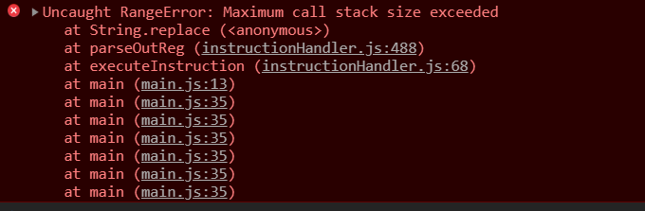
Reflection What didn’t go well
Implementing the logic for each instruction proved more difficult and time consuming than originally thought, and more time should have been allocated to that from the beginning. A float day had to be used to clean up the instruction logic.
We did not forsee the issue of running out of memory while running an assembly file that operates indefinitely. Chrome, for instance, would throw an error after only a few seconds of executing the infiniteLoop.txt test case.

Slide 21
Reflection Something to Improve
Moving forward, we will need to spend more time at the beginning of the increment estimating which parts will take the most time, and assign team members accordingly. If we can divide up the work more evenly, we’ll be able to accomplish more even when we can’t have a team meeting.
Looking at the limits and constraints of using a browser implementation were not really taken into account when coding began, but will need to be for any added features.

Slide 22
Overview
Project Description
Requirements
Implementation
Testing
Demonstration
Reflection

